Slide 1

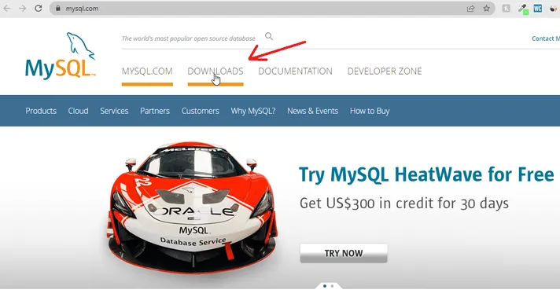
Installing MySQL
Downloading MySQL Installer 8.0.28(Step 1)
We need to download the MySQL installer for Windows in the first step.
To download the installer, visit the official website of MySQL through this link. www.mysql.com
After visiting the website, click on the DOWNLOADS menu button, as shown in the image below.

Slide 2
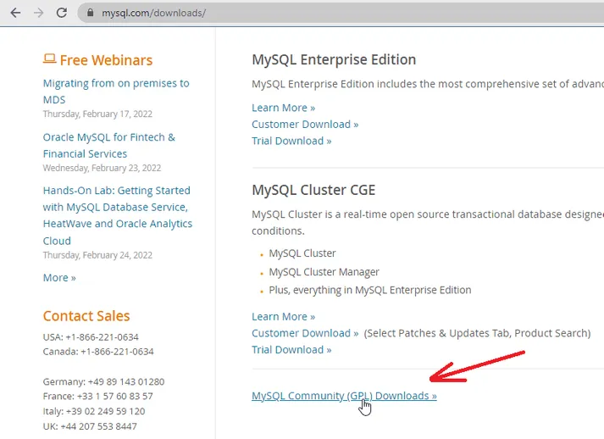
Installing MySQL
After clicking on the DOWNLOADS menu, scroll down the webpage, and you will find a link MySQL Community (GPL) Downloads » . Click on that link to proceed further

Slide 3
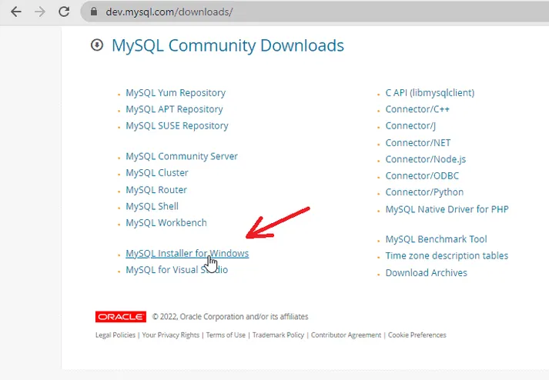
Installing MySQL
After reaching there under community downloads, click on MySQL Installer for Windows because we want it for Windows 10.

Slide 4
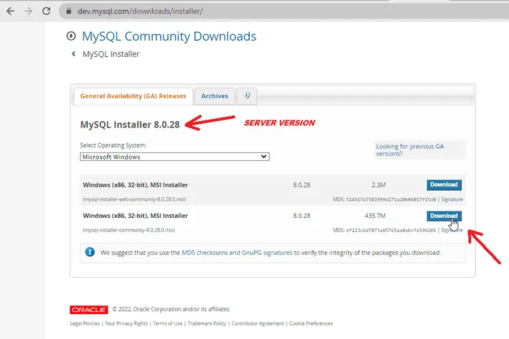
Installing MySQL
After that, you will find two download buttons for the MySQL Installer. The first one is the web Installer, and the second one is the one we will download to our system.

Slide 5
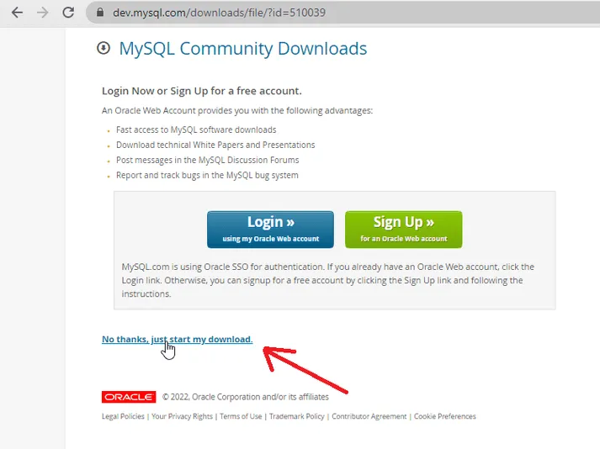
Installing MySQL
After clicking on the download button, it will ask to login or sign-up for the Oracle web account. You can login or sign-up for the account if you wish to otherwise if you are only concerned about downloading the file, then click on the link No thanks, just start my download

Slide 6
Installing MySQL
Installing MySQL Installer (Step 2)
After you have downloaded the file, locate the file’s location in your system and then double click on it to start the installation process.
After the installation starts, it will ask you to choose the setup type, and I will select the custom installation, as you can see in the figure below and then click on the Next button to proceed.
Custom installation allows you to select exactly which products you would like to install.

Slide 7
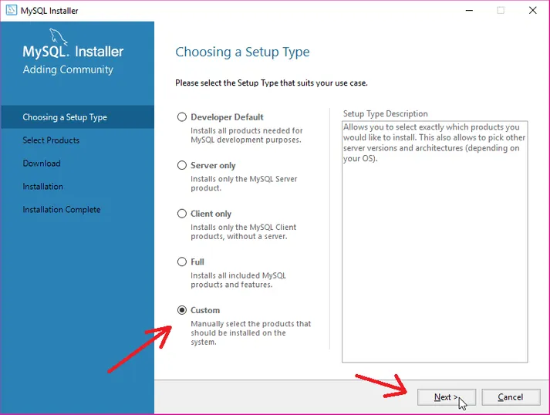
Installing MySQL

Slide 8
Installing MySQL
After that, select the products that you want to install and move them to the right side using the arrow button where “Products To Be Installed” is written.
I will install three products
MySQL Server
MySQL Workbench – The GUI application to develop for and manage the server.
MySQL Shell – The new MySQL client application to manage MySQL Servers and InnoDB cluster instances.
Then click on the Next Button.

Slide 9
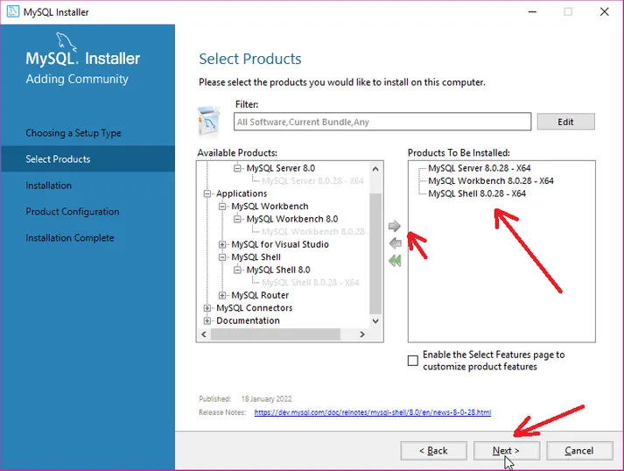
Installing MySQL

Slide 10
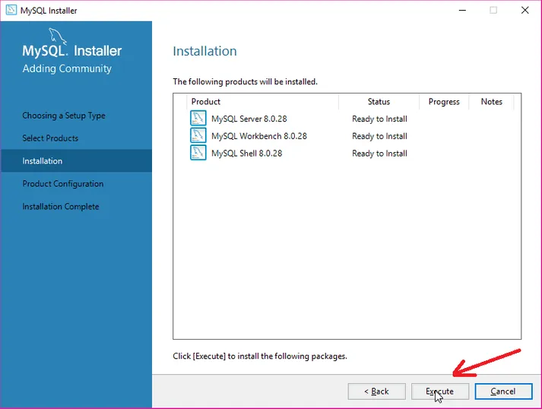
Installing MySQL

Slide 11
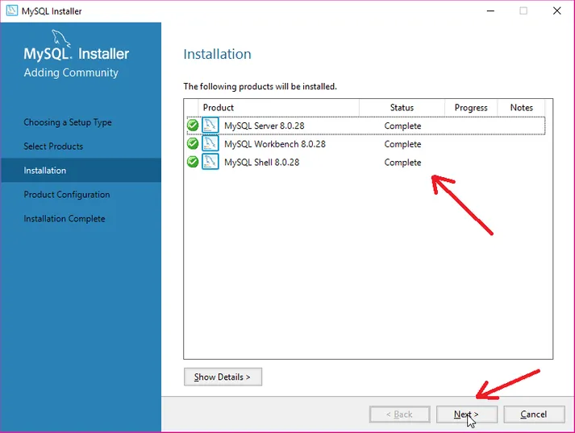
Installing MySQL

Slide 12
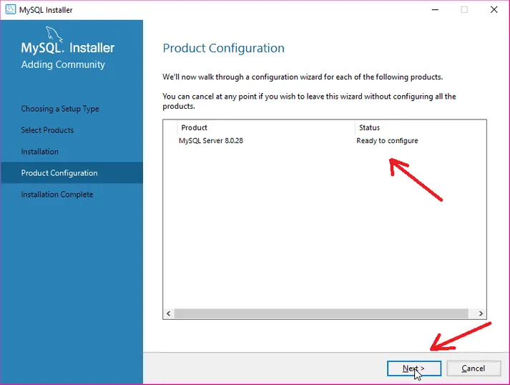
Installing MySQL

Slide 13
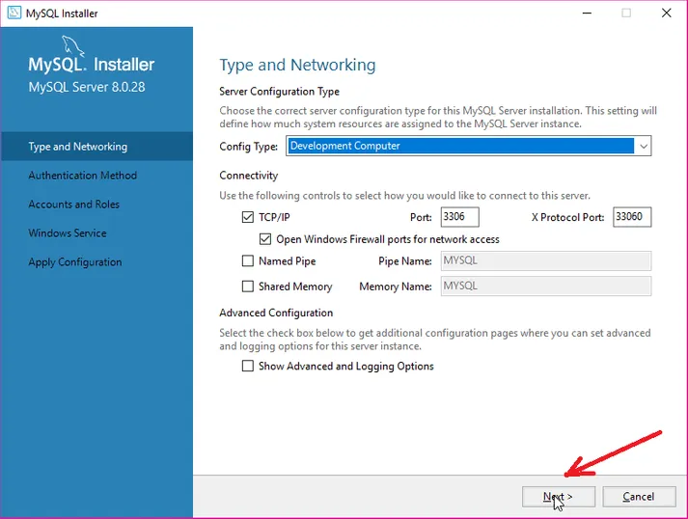
Installing MySQL
Next, it will ask you to choose the server configuration type for the MySQL Server installation and how you would like to connect to this server.
Leave it as default and click on the Next Button.

Slide 14
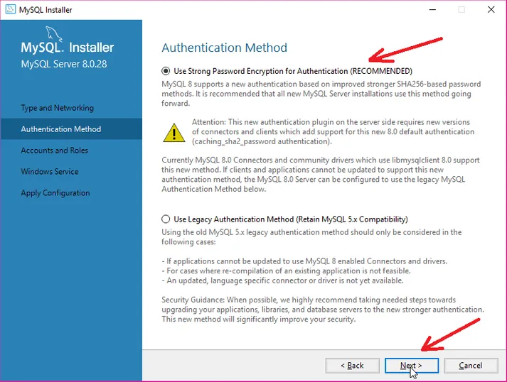
Installing MySQL
Next, it will ask you to choose the authentication method.
Select “Use Strong Password Encryption for Authentication.”
Then click on the Next button.

Slide 15
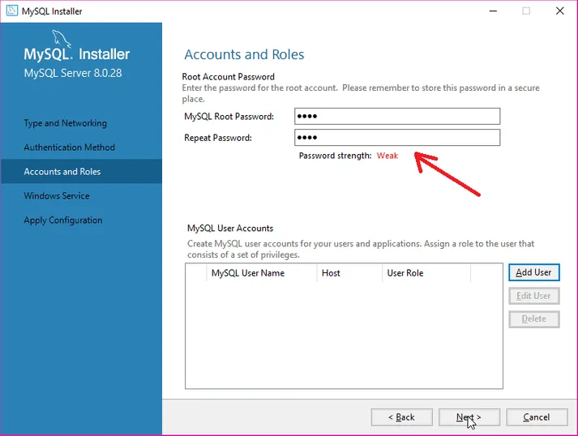
Installing MySQL
Next, it will ask you to enter the password for the root account, My password is Mithresh@17

Slide 16
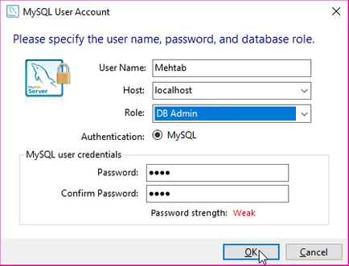
Installing MySQL
You can also add new users for your MySQL applications and assign them roles consisting of a set of privileges.
To add a new User, click on the Add User button.
After you click on the Add User button, a new window will be opened, and there you have to specify the username, password and database role and then click on the OK button to add the user.

Slide 17
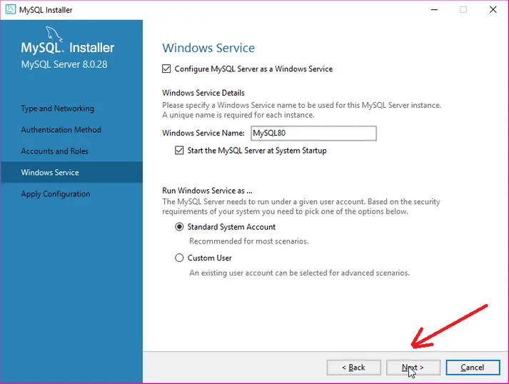
Installing MySQL
Then click on the Next Button to proceed.
Now you will see the Window Service and the Window Service name as MySQL80. Everything is fine, and you need to click on the Next button to proceed.

Slide 18
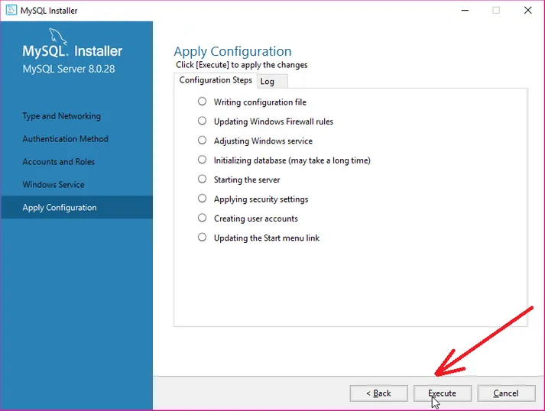
Installing MySQL
Now you will see the Apply Configuration Window. Click on the Execute button to apply the configurations.

Slide 19
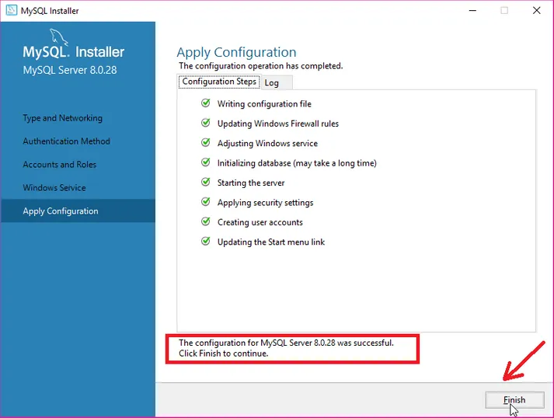
Installing MySQL

Slide 20
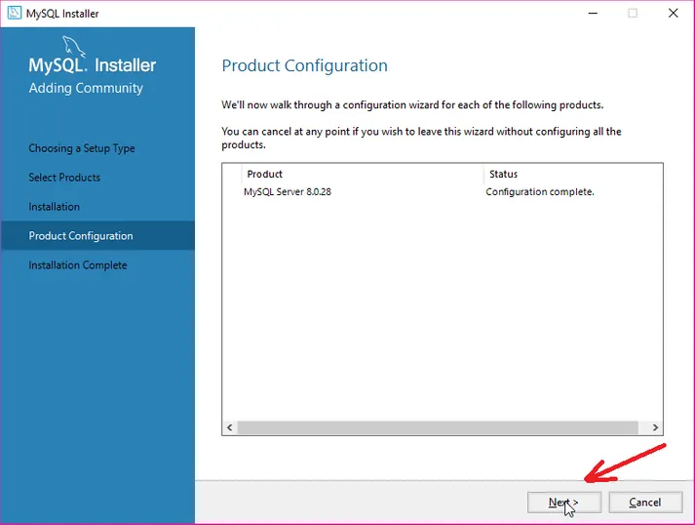
Installing MySQL

Slide 21
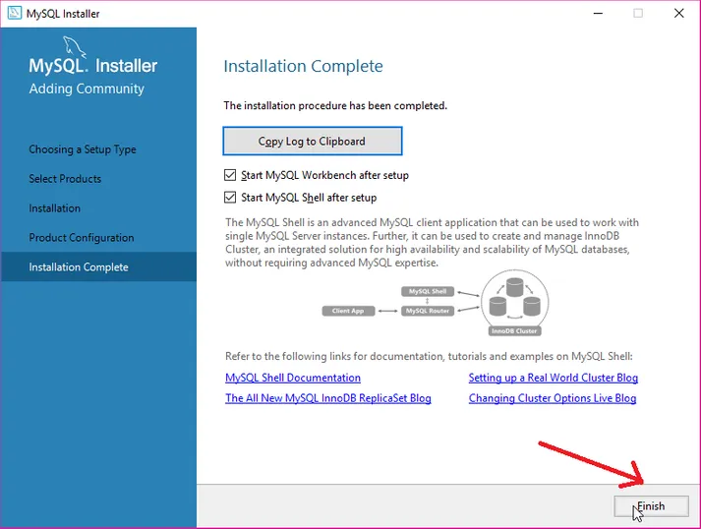
Installing MySQL

Slide 22
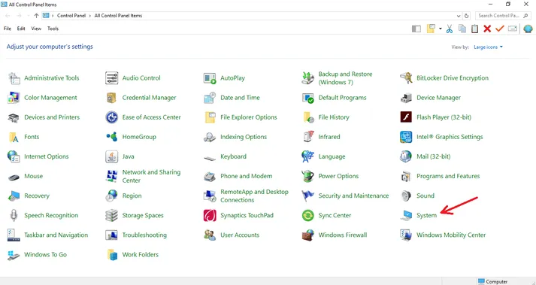
Installing MySQL
Setting the Path for MySQL Tools (Step 3)
Go to the Control Panel.
Select System as shown in the figure below.

Slide 23
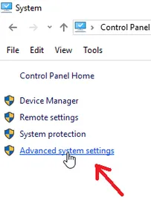
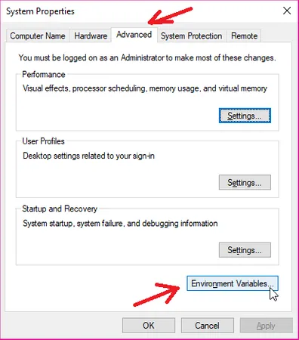
Installing MySQL
Then select Advanced System Settings as shown in the figure below.

Slide 24
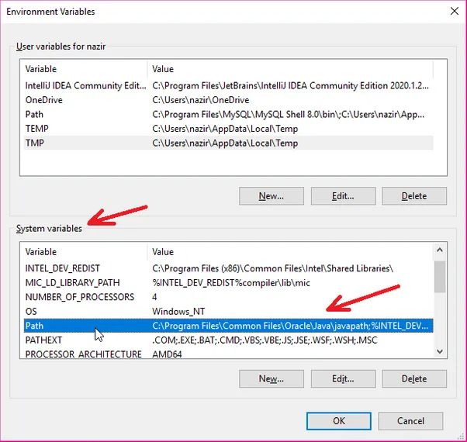
Installing MySQL

Slide 25
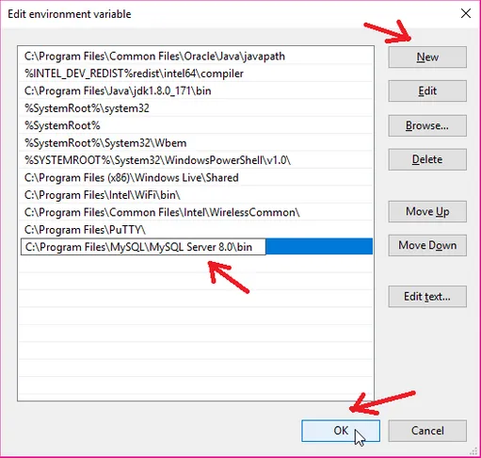
Installing MySQL
Next, you will see another dialog box that will appear where you have to click on the New button, and then you have to paste the complete pathname of the MySQL bin directory. For example – ( C:\Program Files\MySQL\MySQL Server 8.0\bin )
Next, click on the Ok button to complete setting the Path process.

Slide 26
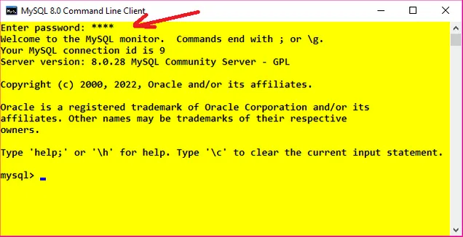
Installing MySQL
Creating Database in MySQL Command Line Client (Step 3)
Open MySQL Command Line Client and then enter the password.
It is the same password you gave while installing the MySQL server in your system.
Enter the correct password and click the enter button.

Slide 27
Installing MySQL
Now to create the database, give the query like this CREATE DATABASE databasename;
Write the query and press enter to create the database.
To check whether my Database has been successfully created or not, we can again give the query SHOW DATABASES;
Creating Table inside Database in MySQL (Step 4)
To create a table inside the database, first we need to use that database using the following query.
For this example, I am going to create a table Mehtab with the following fields.
Name
City
CREATE TABLE Mehtab(Name varchar(30), City varchar(30));
CREATE DATABASE student;
SHOW DATABASES;
USE databasename;

Slide 28
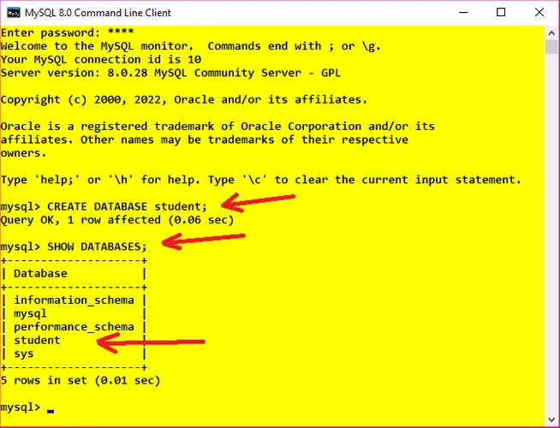
Installing MySQL

Slide 29
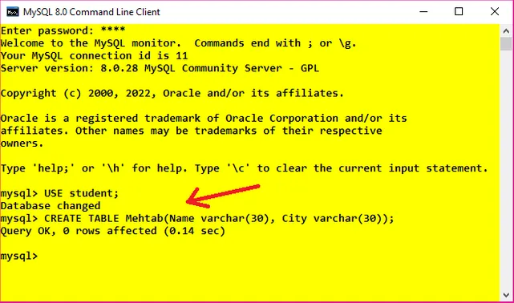
Installing MySQL

Slide 30
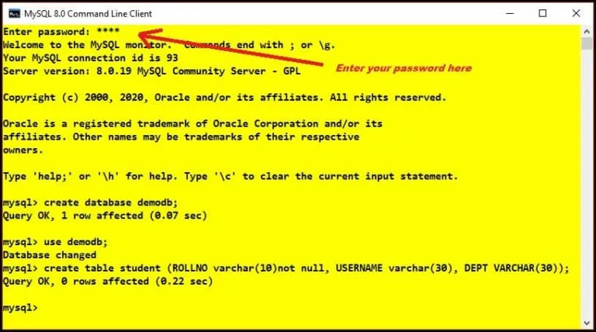
JDBC
open MySQL command-line client, and enter your password.
This is the same password you provided while installing the MySQL database
Now create a database named “demodb” and a table named “student” inside it with columns
ROLLNO
USERNAME
DEPT

Slide 31
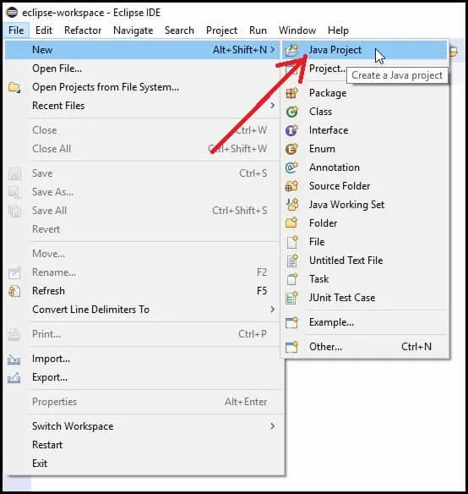
JDBC
Creating a Java Project in Eclipse
Open Eclipse IDE and click on the Java Project under the new section of File Menu (File>>New>>Java Project).

Slide 32
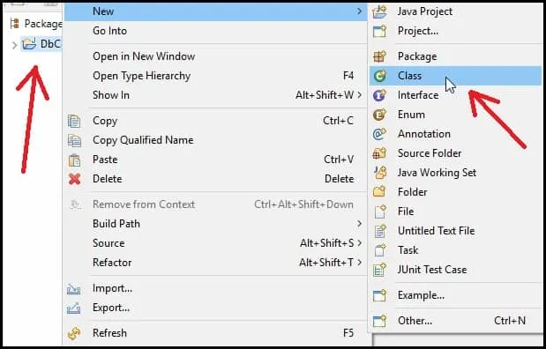
JDBC
Now right click on the project and create a new Java class (New>>Class).

Slide 33
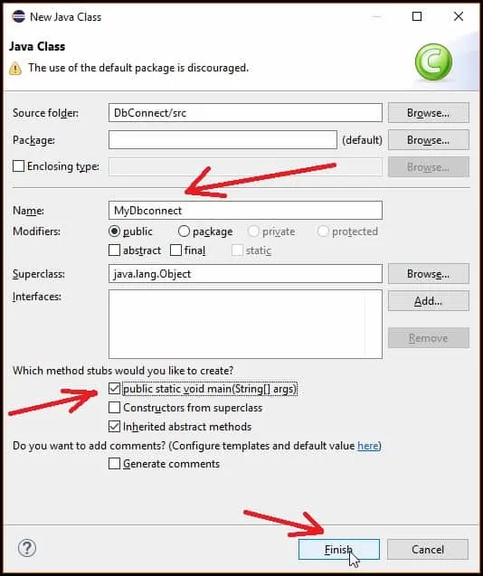
JDBC
Now give a name to your class(MyDbconnect in this Example), tick mark on the public static void main(String[] args), and then click on the Finish button

Slide 34
JDBC
Adding MySQL connector jar file in Eclipse
In order to connect your java program with MySQL database, you need to include MySQL JDBC driver which is a JAR file, namely mysql-connector-java-8.0.28.jar. The version number in the Jar file can be different.
You can download the latest version of MySQL connector from this link (MySQL Connector Java download) https://dev.mysql.com/downloads/connector/j/ .
After visiting the link, select platform independent from the drop-down menu as shown in the figure below.

Slide 35
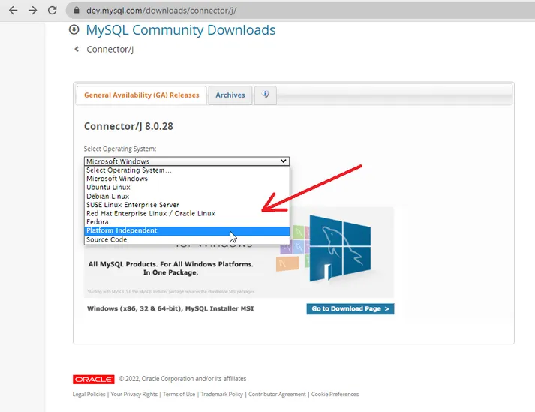
JDBC

Slide 36
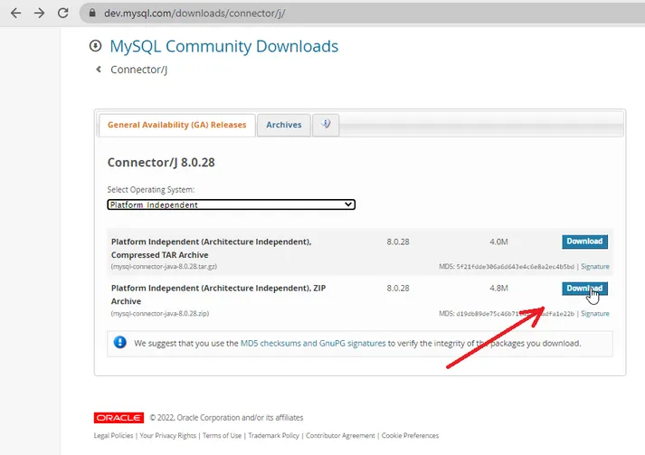
JDBC

Slide 37
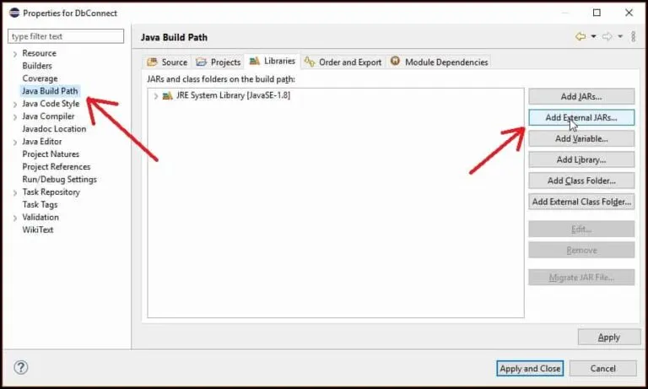
JDBC
Extract the zip archive and you will get the jar file.
Next, you have to include this jar file into your program so that you will be able to connect your java program with MySQL database.
Right-click on the project, go to the properties section then select Java Build Path and click on the Add External JARs button.

Slide 38
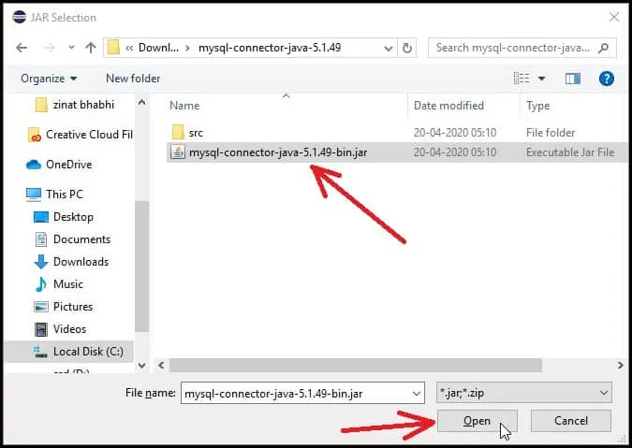
JDBC
After clicking on the button a pop-up window will appear where you have to select and open the jar file.

Slide 39
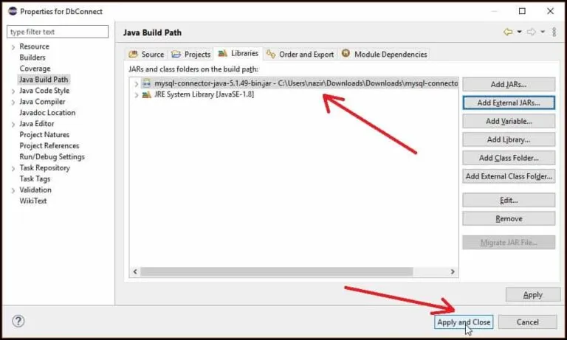
JDBC
You can see the added Jar file as shown in the figure below. Now click on the Apply and Close button.

Slide 40
Inserting values into DB using JDBC
import java.sql.*;
public class MyDbconnect {
public static void main(String[] args) {
try {
Connection connection = DriverManager.getConnection("jdbc:mysql://localhost:3306/demodb", "root", "root");//Establishing connection
System.out.println("Connected With the database successfully");
//Creating PreparedStatement object
PreparedStatement preparedStatement=connection.prepareStatement("insert into Student values(?,?,?)");
//Setting values for Each Parameter
preparedStatement.setString(1,"1");
preparedStatement.setString(2,"Mehtab");
preparedStatement.setString(3, "Computer");
//Executing Query
preparedStatement.executeUpdate();
System.out.println("data inserted successfully");
} catch (SQLException e) {
System.out.println("Error while connecting to the database");}}}

Slide 41
Thank You
Department of Computer Science and Engineering

